Slide 1
DSE using Alloy
Project part

Slide 2
Contents
Assignment
Meta-modeling using Alloy
Creating solutions using Alloy
Exporting solutions to Modelica
Simulation

Slide 3
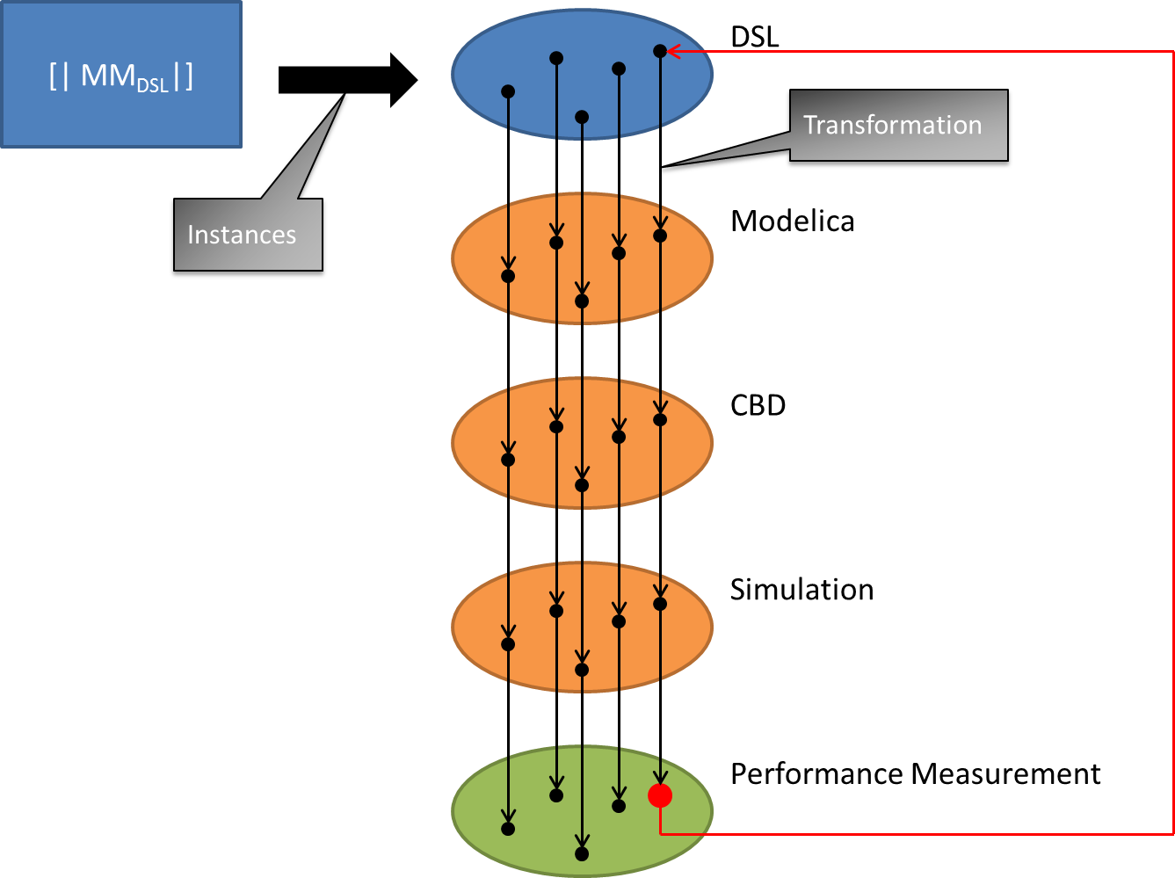
Assignment
Notes:
"how would I recognize that X has happened” vs "how can I accomplish X"

Slide 4
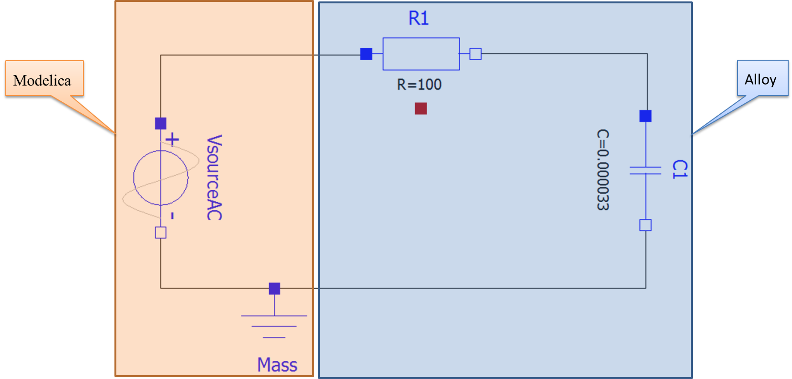
Assignment
Notes:
"how would I recognize that X has happened” vs "how can I accomplish X"

Slide 5
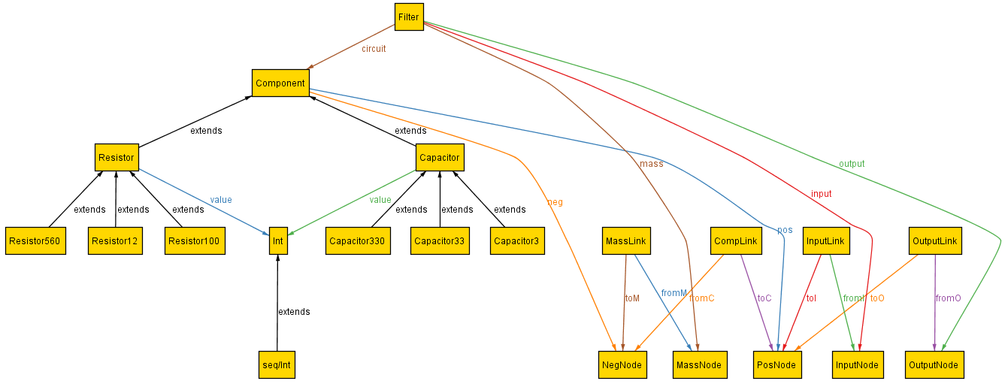
Meta-modeling using Alloy
abstract sig Component {
pos : one PosNode,
neg : one NegNode
}
abstract sig Resistor, Capacitor extends Component {
value : Int
}
//Resistor of 12 Ohm
sig Resistor12 extends Resistor {
}
{ //Appended fact => constraint: value of the resistor
value = 12
}
one sig Filter{
input : InputNode,
output : OutputNode,
mass : MassNode,
circuit : set Component
}
some sig CompLink {
fromC : NegNode,
toC : PosNode
}

Slide 6
Meta-modeling using Alloy
Constrain by using facts:
  Floating components
  Floating nodes
  Self links
  Duplicate links
  Not linked nodes

Slide 7
Work flow
Notes:
"how would I recognize that X has happened” vs "how can I accomplish X"

Slide 8
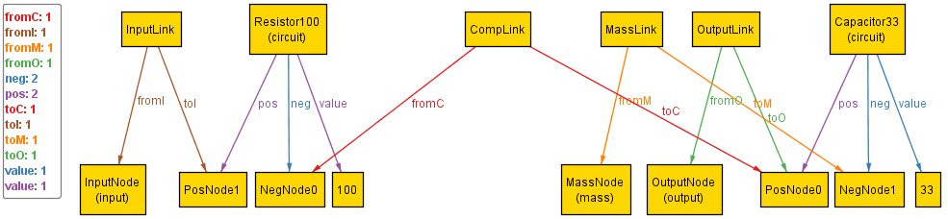
Creating solutions using Alloy

Slide 9
Work flow
Notes:
"how would I recognize that X has happened” vs "how can I accomplish X"

Slide 10
Exporting solutions to Modelica
Parser
  Retrieve the filters
  For each filter, retrieve its components
  For each filter, retrieve the links
  => Stored in multi-dimensional arrays

Slide 11
Exporting solutions to Modelica
Creation of the Modelica-file
  Look-up table
    [‘Resistor100$0', '100', `PosNode$1', 'NegNode$0']
    [‘R1', '100', `R1.p', ‘R1.n']
  Creation of the dynamic part
  Creation of the static part

Slide 12
Work flow
Notes:
"how would I recognize that X has happened” vs "how can I accomplish X"

Slide 13
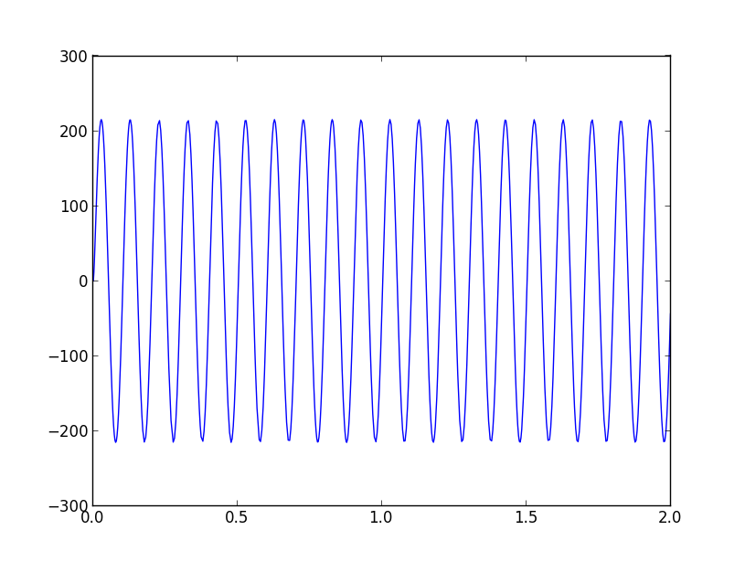
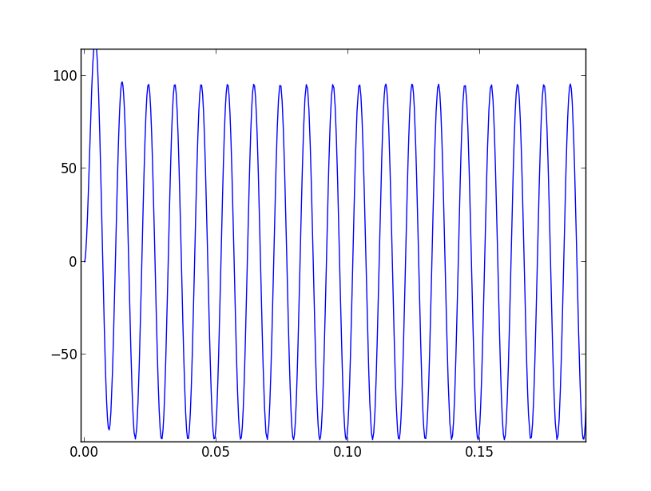
Simulation
Vsource = 220V @ 10 Hz
Vsource = 220V @ 100 Hz

Slide 14
Future work
Reduce the human interaction
  Alloy API
  Jmodelica Python Interpreter
Integrate performance measurement

Slide 15


